Slide 1
Front End Engineering-I
Project
Name : Deepraj singh (2110992200)
Faculty Coordinator: MR. Lavish Arora
:
Chitkara University Institute of Engineering and Technology, Chitkara University, Punjab

Slide 2
RESTAURENT
WHEEL

Slide 3


Table of Contents
Introduction
Technical Details
Key Features
Project Highlights
Conclusion
References/Links used

Slide 4
Introduction
Restaurant Wheel is Delhi's corporate food-commerce tiffin service which allows you to order delicious home-style food and Snacks in convenient packaging over Phone or Online.
Restaurant Wheel delivers nutritious meals South Delhi in Hot case boxes and we serve a different meal every day of the month! Or customize your meal what you like to eat.
Our customers love Restaurant Wheel tiffin service for its authentic Indian food and customer eservice.

Slide 5
Technical Details
HTML is the standard markup language used to create web pages. It is essential to ensure that the HTML code is clean and valid, including using proper headings, meta tags, and structured data. This helps search engines understand the content of the web pages and index them properly.
CSS is used to style the web page and make it visually appealing to users. While CSS does not have a direct impact on SEO, it can indirectly affect the user experience. A well-designed website that is visually appealing and easy to navigate can improves the user experience
JavaScript is a programming language used to add interactivity and dynamic content to web pages. It can be used to create animations, pop-ups, and other interactive elements that can enhance the user experience.
A responsive design that works well on different screen sizes and devices is essential for SEO as mobile traffic continues to increase.
A fast loading website is crucial for SEO. You can improve page speed by optimizing images, minifying code, and leveraging caching.
A well-structured URL that includes the target keyword can help search engines understand the
content of the page.
jQuery is a lightweight JavaScript library. It's sole purpose is to make it much easier to use
Javascript on your website.
Linking to other relevant pages on your site can help search engines understand the context of your content and improve the user experience.

Slide 6
Key Features
1. Home made food
2. Daily Menu Change
3.Easy Ordering
4.Easy Cancellation
5.Discount Offer/coupons
6.Snacks ordering

Slide 7
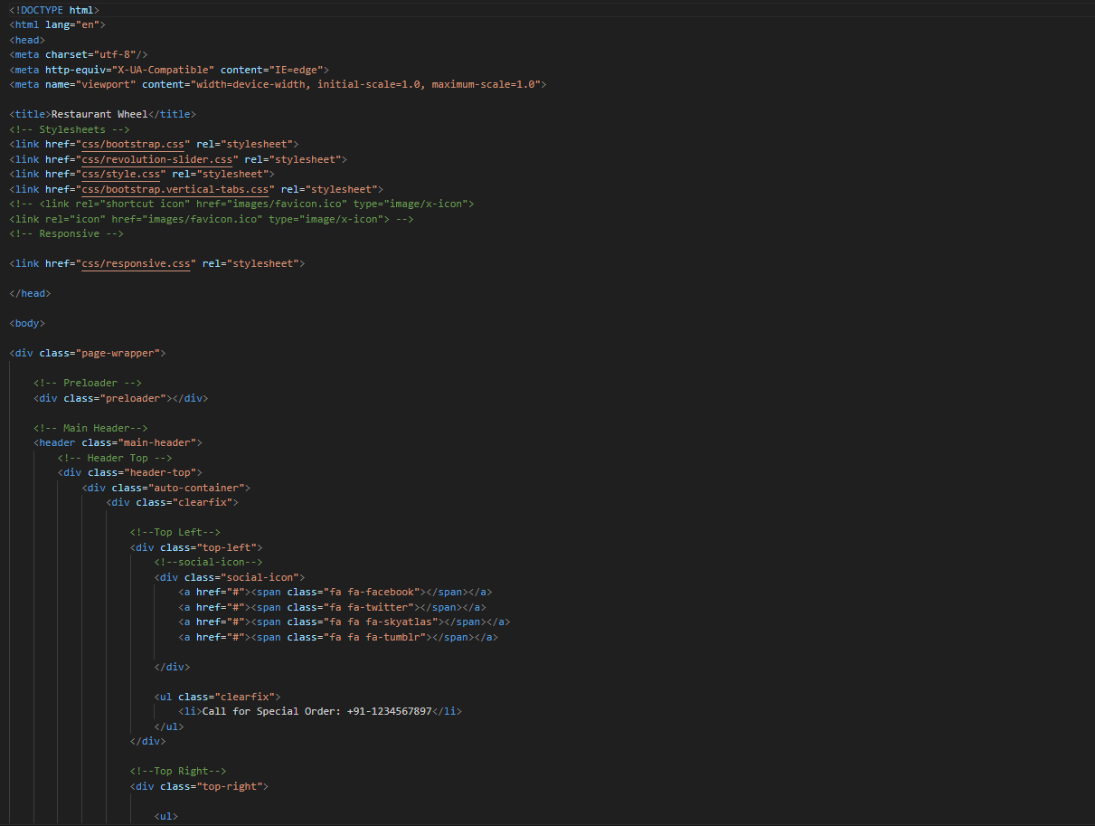
Code Highlight

Slide 8
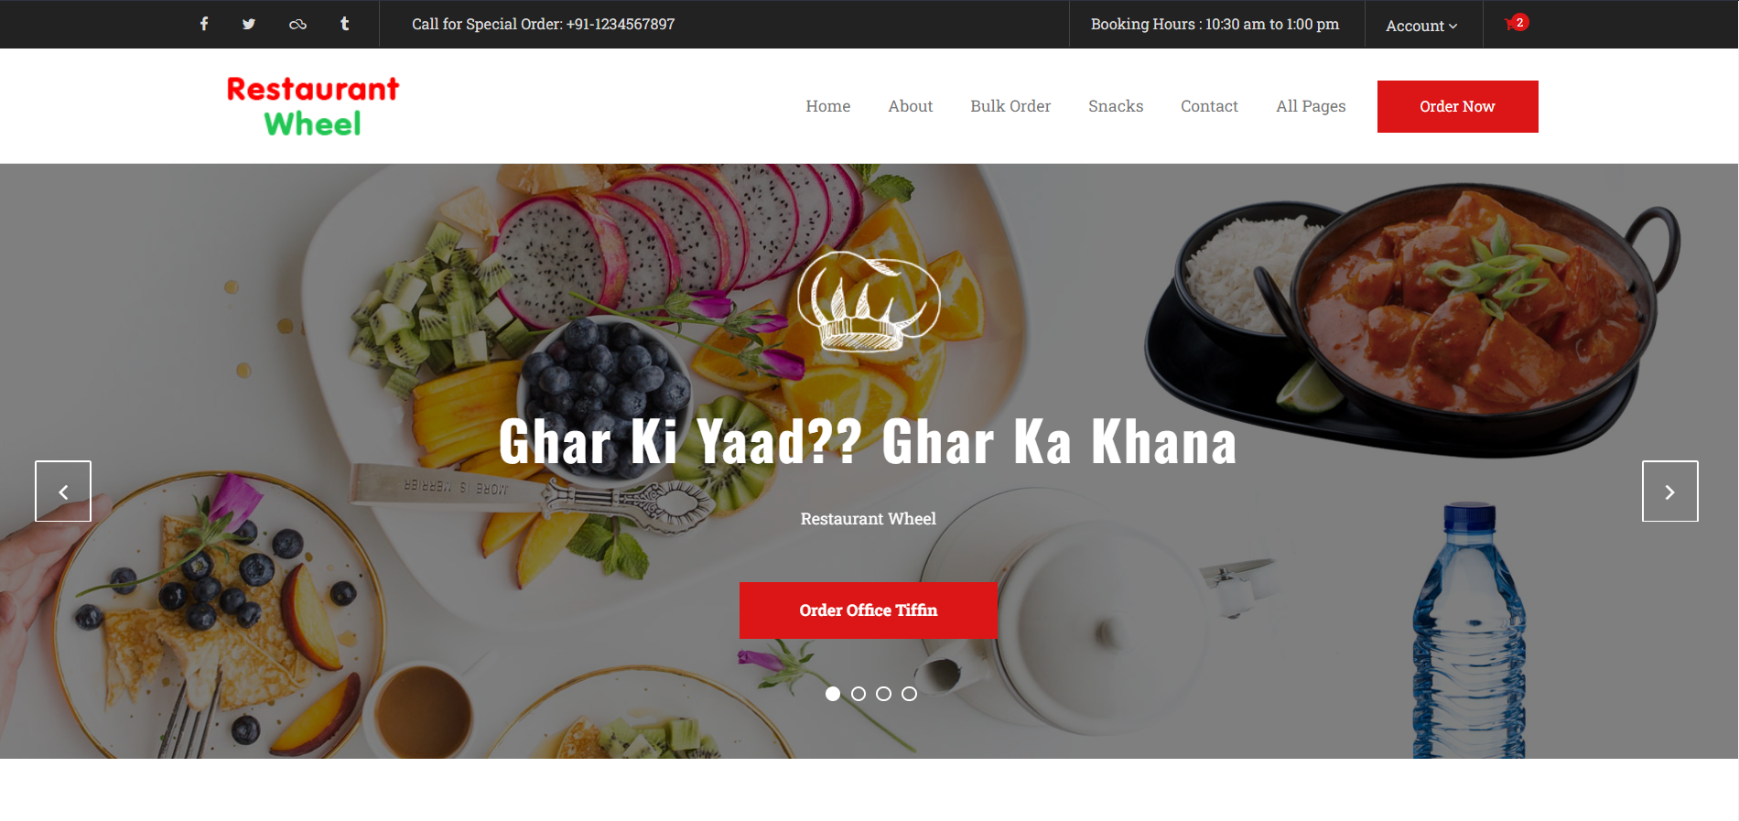
Project Highlights

Slide 9
Conclusion
When trying to decide where to dine‚ either at a local restaurant or at a western restaurant‚ patrons should consider several aspects that concern these dining places. Some of these aspects include the food selection‚ the service provided and the ambience of each restaurant. When we talk about the food selection‚ both the restaurant must have a variety of menus as this is one that captured the quality required to be on every restaurant.

Slide 10
References/Links use
The link used is:-
https://www.w3schools.com/
https://stackoverflow.com/
https://www.geeksforgeeks.org/
HTML and CSS: Design and Build Websites
Learning Web Design: A Beginner's Guide to HTML, CSS, JavaScript, and Web Graphics

Slide 11


